Slide 1



Player One, you are financially ready
in 3, 2, 1 . . .
Ng Yujin Benjamin
Tan Jia Yun
Prepared for :
Ferne Lo Hui Fen
Melvin Ong
Hum Shi Jing

Slide 2
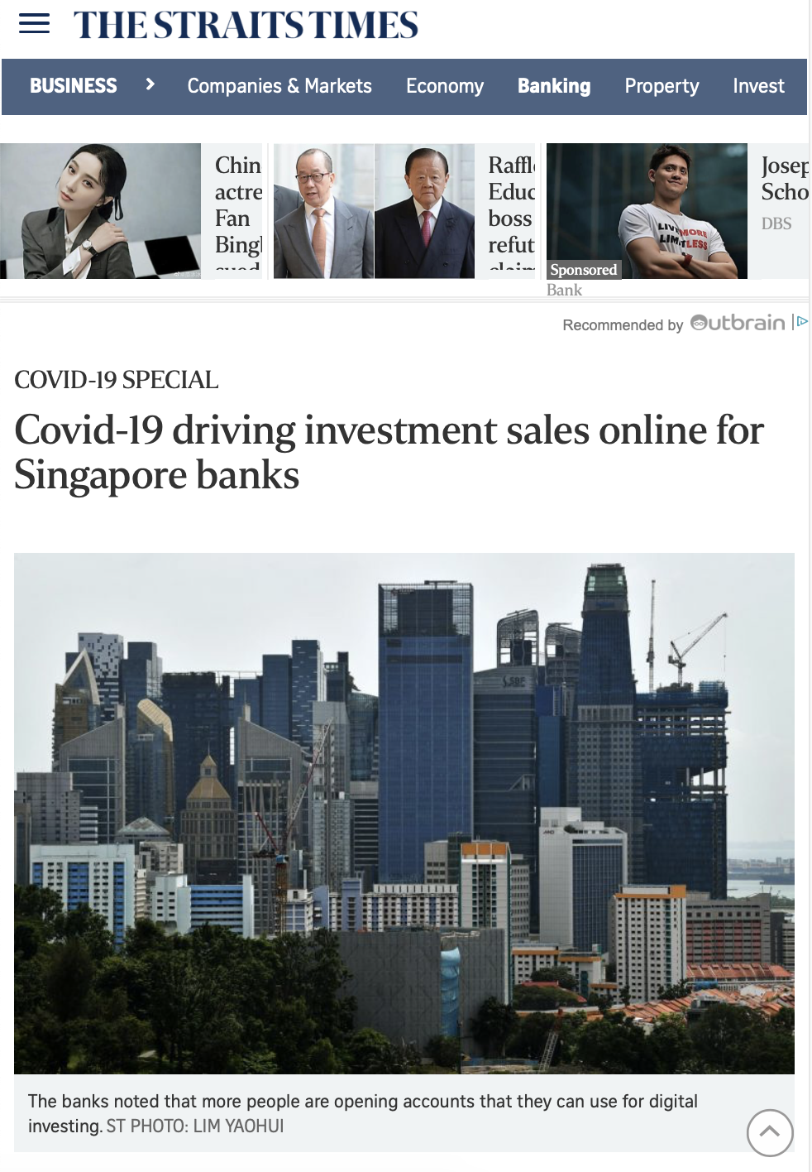
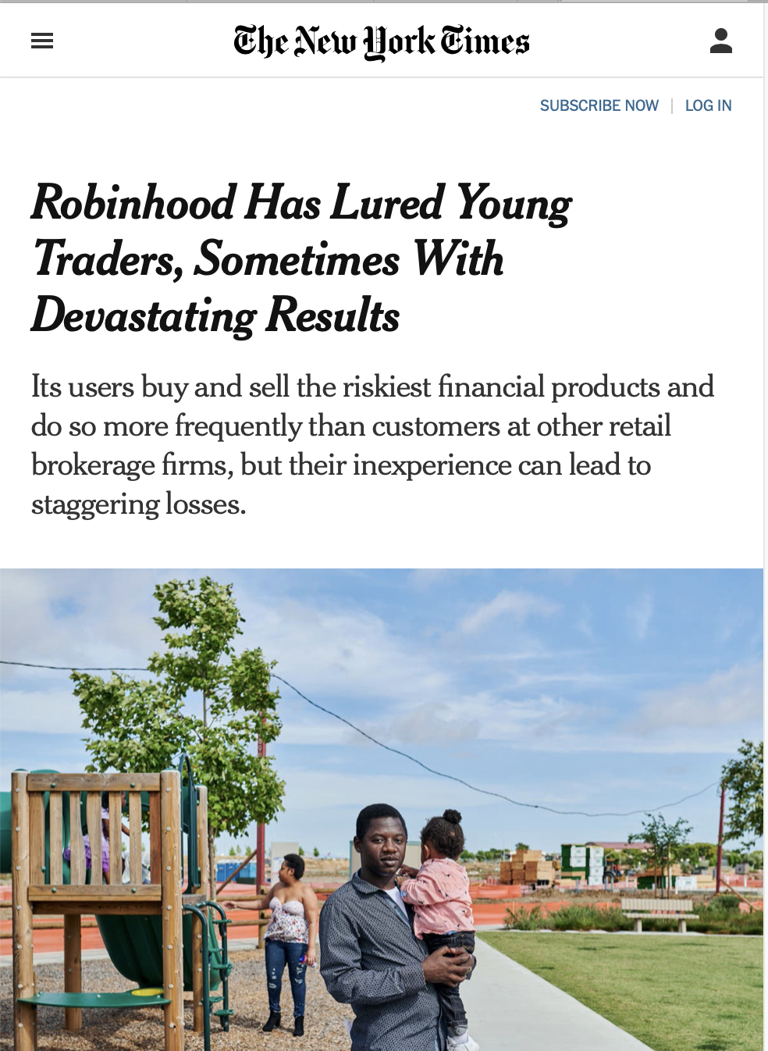

Due to a increasing trend of youths investing in the recent years and further stimulated by the Covid-19 situation...
Youths have increased interest in investments and generating wealth.
Dive into investments without knowing how or what.
Lack of oversight of current financial situation.
DRIVERS BEHIND OUR IMPLEMENTATION
1
2
3

Slide 3

To help young individuals understand financial products easily, our page allows them to...
Understand their current financial standing
It is important to understand one’s financial well-being before embarking on any investment journey. As a young individual, it can be difficult to evaluate and determine how much they can afford to invest. Our application will provide customized information and advice based on their current assets (savings, income) and liabilities (debt).
Understand the different investment products in a jargon-free manner
It can be confusing to understand the different terms used in the financial scene. Our application will serve as a one-stop guide to help young individuals understand the various investment products available. The information provided will enable them to make better financial decisions.
Find out the products suitable for their profile
Based on their investment objectives, financial standing and risk profile, our application will recommend suitable financial products to young individuals. The recommendations will serve as a starting point for individuals who are unsure of what to invest in.
Have an overview of their portfolio
A consolidated investment portfolio is important in helping an investor keep track of their different investments. The portfolio builder will provide users with an interactive way to build and manage their investment strategy.

Slide 4



We provide a comprehensive solution through the following steps
FINANCIAL CALCULATOR
INVESTMENT RECOMMENDER
INTERACTIVE DASHBOARD
Budget Calculator
Net Worth Calculator
Personalized investment advice
To monitor your assets and get the news related to it

Slide 5



We made use of the following APIs...
Due to the limitations of the APIs, limited to certain instruments, we conducted web scraping from
ALPHA VANTAGE API
NEWS API
Retrieves data on instrument based on the ticker code provided.
Retrieves news data on based on the category provided.

Slide 6







Going to Cloud, a serverless architecture.
Frontend
Backend
AWS Elastic Load Balancer
AWS S3
AWS EC2
AWS Cognito
Notes:
AWS EC2
Hosting of Backend Application. High scalability and flexibility
AWS S3
Hosting of Frontend Application
High availability
Easy management
AWS Cognito
For identity access management
AWS Elastic Load Balancer
Redirects traffic to ensure high availability
Flexible scalability and reduces downtime

Slide 7

What is in for the user?
Have a glance at the user’s financial standing.
Monitor investments at one glance.
Share your profile to others such as your financial advisor without them knowing your exact holdings, so they can provide advisory services.

Slide 8

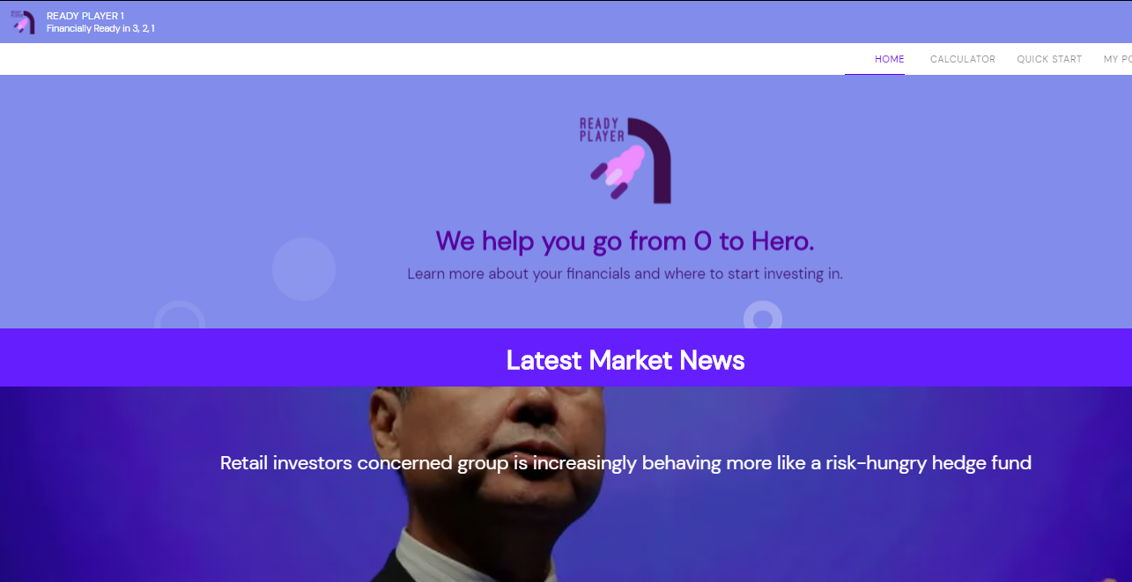
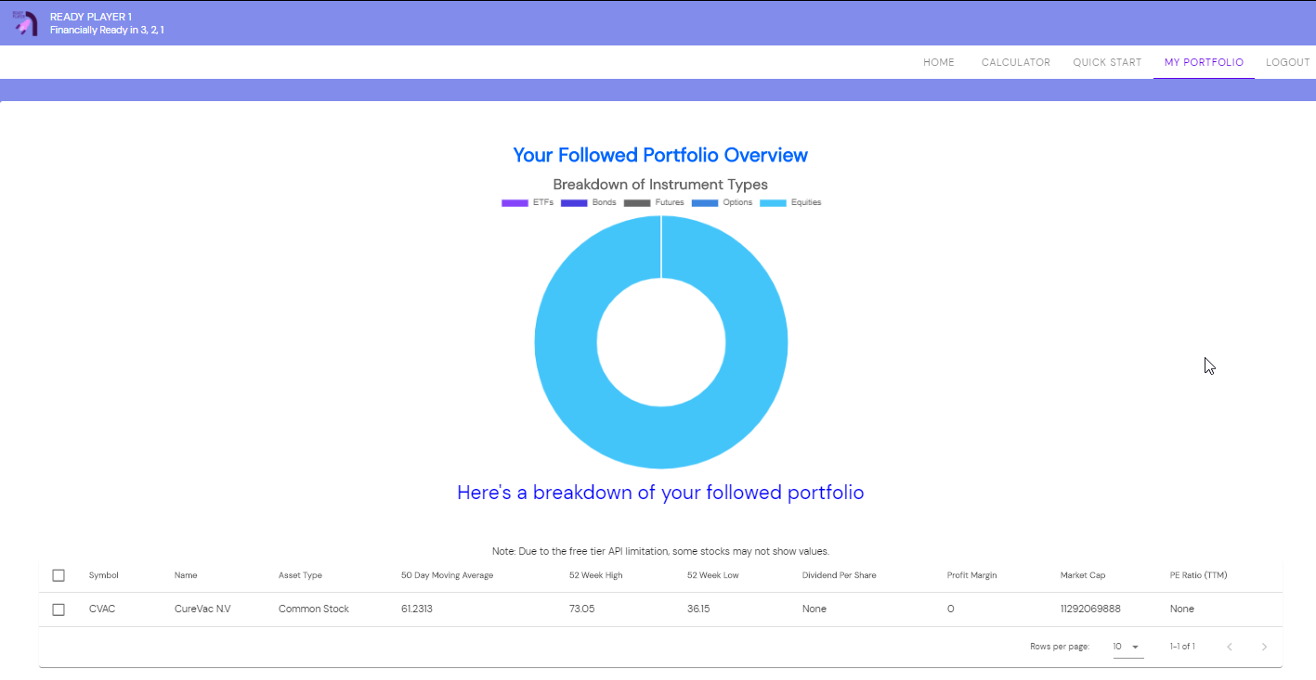
A look at how our final product looks like...
Link to site:
http://frontendrp1.s3-website-ap-southeast-1.amazonaws.com/

Slide 9
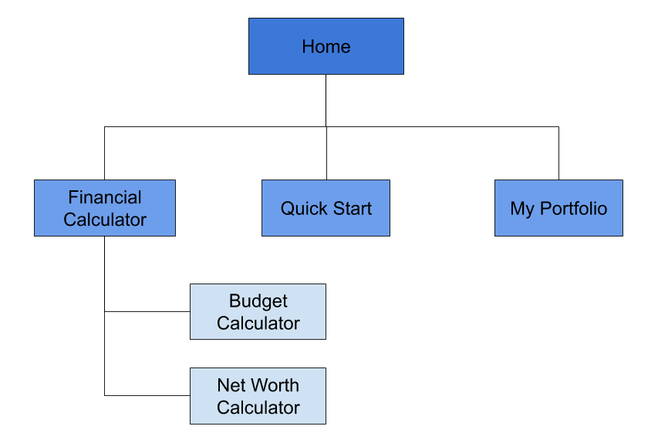
An overview of the application’s navigation diagram

Slide 10
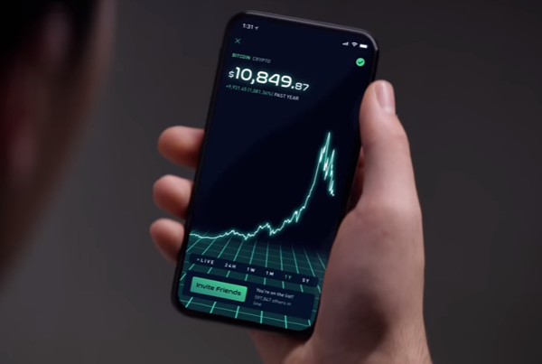
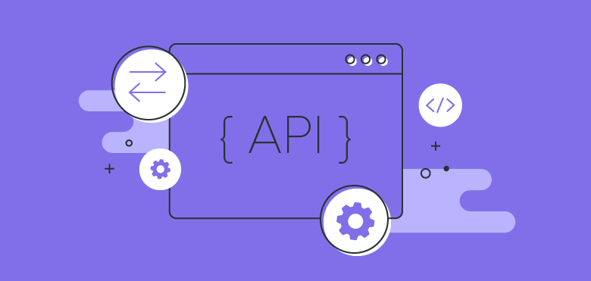

Going forward we hope to scale to provide more offerings to enhance the whole user experience such as...
RECOMMEND PLATFORMS FOR USERS
DISPLAYING MORE VARIETY OF INSTRUMENTS
PROJECTION OF SAVINGS
Suggest the suitable platforms for the user to use based on ratings or link up with advertisers.
An paid API or internal API provided will allows us to access more market data to display the other instruments’ data.
Given user’s asset and loan, compute and reflect the user’s net cash flow and assets over time - 5, 10, 20 years on a reactive chart.

